Slide 1
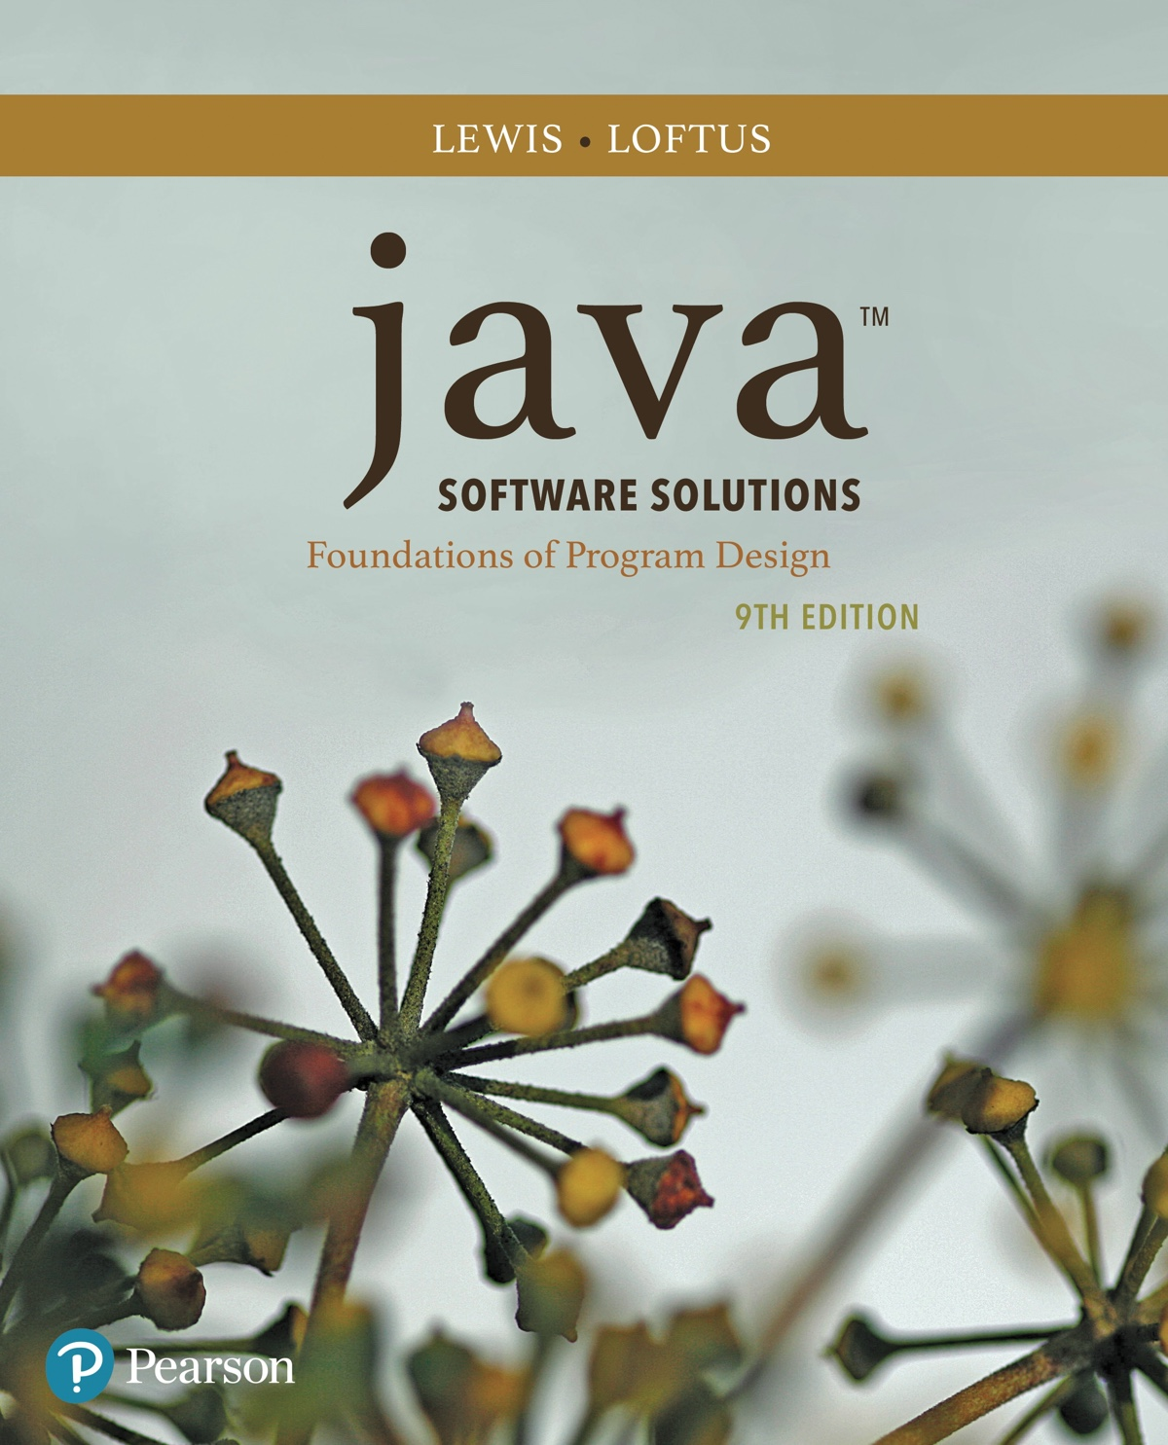
Chapter 2 Data and Expressions
Java Software Solutions
Foundations of Program Design
9th Edition
John Lewis
William Loftus

Slide 2
Data and Expressions
This week we’ll take a look at how Java handles some fundamental programming concepts.
Specific details focused on are:
character strings
primitive data
the declaration and use of variables
expressions and operator precedence
data conversions
accepting input from the user (which will effectively introduce OOP)

Slide 3
Outline
Character Strings
Variables and Assignment
Primitive Data Types
Expressions
Data Conversion
Interactive Programs

Slide 4
Character Strings
A string literal is represented by putting double quotes around the text
Examples:
"This is a string literal."
"123 Main Street"
""
Every character string is an object in Java, defined by the String class
Every string literal represents a String object

Slide 5
Char vs String
A character (char) is a single Unicode symbol represented enclosed by single quotes (Ex: ‘a’, ‘A’, ‘é’, ‘᧴’)
A string uses double quotes and represents a word, phrase, or other grouping of associated Unicode symbols.
A String is, for all intents and purposes, an array of characters.
A string may have up to 2.15e9 characters (enough for most applications).

Slide 6
The println Method
In the Lincoln program from Chapter 1, we invoked the println method to print a character string
The System.out object represents a destination (the monitor screen) to which we can send output
System.out.println("Whatever you are, be a good one.");
object
method
name
information provided to the method
(parameters)

Slide 7
The print Method
The System.out object has other uses than println.
The print method is similar to the println method, except that it does not advance to the next line
Therefore anything printed after a print statement will appear on the same line
See Countdown.java

Slide 8
String Concatenation
The string concatenation operator (+) is used to append one string to the end of another
"Peanut butter " + "and jelly"
It can also be used to append a number to a string
A string literal cannot be broken across two lines in a Java program
– As such, very long text strings (ex: long sentences or paragraphs) will likely require concatenation.
See Facts.java

Slide 9
Operators with Multiple Functionality
The + operator is also used for arithmetic addition
The function that it performs depends on the type of the information on which it operates: Case 1: Both operands are strings. Case 2: Both operands are numeric. Case 3: One operand is a string and one is a number.
We will take a look at how each of these scenarios are handled (two are simple, one is not).

Slide 10
Multiple Functionality (cont)
+ Operator Case 1: Both operands are strings. - Easy: The two strings are concatenated (we’ve seen this.)
+ Operator Case 2: Both operands are numeric. - Easy: The two numbers are added (but the format of numbers may impact results, as we’ll discuss!)
+ Operator Case 3: One operand is a string and one is a number. - Trickier, but Java makes things simple by converting the numeric argument to a string and concatenating it.
The + operator is evaluated left to right, but parentheses can be used to force the order.
See Addition.java

Slide 11
Quick Check
What output is produced by the following?
System.out.println("X: " + 25);
System.out.println("Y: " + (15 + 50));
System.out.println(300 + "Z: " + 50);

Slide 12
Quick Check
What output is produced by the following?
System.out.println("X: " + 25);
System.out.println("Y: " + (15 + 50));
System.out.println(300 + "Z: " + 50);
X: 25
Y: 65
300Z: 50

Slide 13
Escape Sequences
What if we wanted to print the quote character?
The following line would confuse the compiler because it would interpret the second quote as the end of the string
System.out.println("I said "Hello" to them.");
An escape sequence is a series of characters that represents a special character
An escape sequence begins with a backslash character (\)
System.out.println("I said \"Hello\" to them.");

Slide 14
Escape Sequences
Escape sequences are not unique to Java.
- Whenever a symbol’s role could be ambiguous to a compiler (almost always the case for a single or double quote), an escape sequence becomes a necessity.
- Different languages handle escape characters differently, but backslash characters are the most commonly utilized across the board.

Slide 15
Escape Sequences
Escape sequences are used for printing/formatting elements that lack a direct representation.
- For example, a “tab” in writing/spacing may be represented by \t. in Java.
Lastly, escape sequences can be used as an alternate means of inserting a newline using \n
-print(“Hi.\n”) is the same as println(“Hi.”) for most practical purposes.

Slide 16
Escape Sequences
Some Java escape sequences:
Escape Sequence
\b
\t
\n
\r
\"
\'
\\
Meaning
backspace
tab
newline
carriage return
double quote
single quote
backslash
See Roses.java

Slide 17
Quick Check
Write a single println statement that produces the following output:
"Thank you all for coming to my home
tonight," the mysterious figure said to the guests.

Slide 18
Quick Check
Write a single println statement that produces the following output:
"Thank you all for coming to my home
tonight," the mysterious figure said to the guests.
System.out.println("\"Thank you all for " +
"coming to my home\ntonight,\" the mysterious" +
" figure said to the guests.");

Slide 19
Outline
Character Strings
Variables and Assignment
Primitive Data Types
Expressions
Data Conversion
Interactive Programs

Slide 20
Variables
A variable is a name for a location in memory that holds a value
A variable declaration specifies the variable's name and the type of information that it will hold
data type
variable name
int total;
Multiple variables can be created in one declaration
int count, temp, result;

Slide 21
Variable Initialization
A variable can be given an initial value in the declaration
int sum = 0;
int base = 32, max = 149;
When a variable is referenced in a program, its “current” (run-time) value is used.
See PianoKeys.java

Slide 22
Variable Names
An important but subjective aspect to programming is how best to name variables.
Variable names should convey the purpose of a variable in as complete and concise a manner as is possible -A variable name like “x” is likely not meaningful in most contexts. -A variable like “velocityinkilometerspersecond” is far too long to practically useful. -A good compromise might be “velocity_kmps”
By convention, variables are usually represented using lower-case letters.

Slide 23
Assignment
An assignment statement changes the value of a variable
The assignment operator is the = sign
total = 55;
Any previous value that was in total is overwritten
You can only assign a value to a variable that is consistent with the variable's declared type
See Geometry.java

Slide 24
Constants
A constant is an identifier that is similar to a variable except that it holds the same value during its entire existence
As the name implies, it is constant, not variable
The compiler will issue an error if you try to change the value of a constant
In Java, we use the final modifier to declare a constant
final int MAX_LOAD = 250;

Slide 25
Constants
Constants are useful for three important reasons:
First, they give meaning to otherwise unclear literal values
Example: MAX_LOAD means more to a programmer than the literal 250.
Second, they facilitate program maintenance
If a constant is used in multiple places, its value need only be set in one place
Third, they formally establish that a value should not change, avoiding inadvertent errors by other programmers.

Slide 26
Driver Files
While we can put the main function to execute inside any .java class file, sometimes we want to separate testing code from underlying programming logic.
A driver file is one whose purpose is to simply create, test, and debug other code.
– In the context of Java and OOP, driver files typically create and use objects to verify their underlying construction/methods are correct.
See Rectangle.java and RectangleDriver.java

Slide 27
Early Class and Object Discussion
The Rectangle class is the blueprint we defined. - Classes have associated member variables (attributes) and methods.
rect1 and rect2 were two objects of type Rectangle (they can be seen as class “instances.”) - Each rectangle had different dimensions.
Member variables can themselves be classes. - Ex: A car class may have 4 variables that are members of the “tire class.”

Slide 28
Static Methods
The keyword static has multiple uses in Java. - We’ll address static methods, and others at a later date.
A static method is one is that is associated with a class name in general, as opposed to an individual object.
Many staple programming elements are implemented as static methods in Java libraries. - For example, System.out.println and System.out.print are static methods.

